Slide 1
RUNNING FURY
IN UNITY

Slide 2
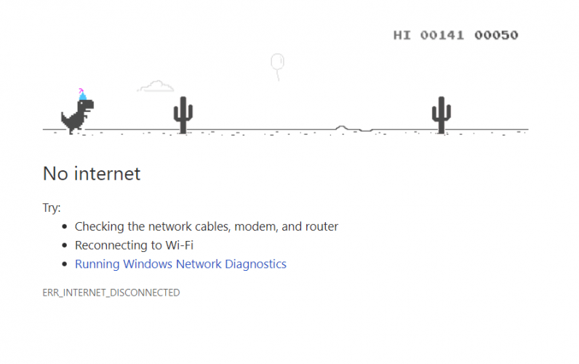
INSPIRATION

Slide 3
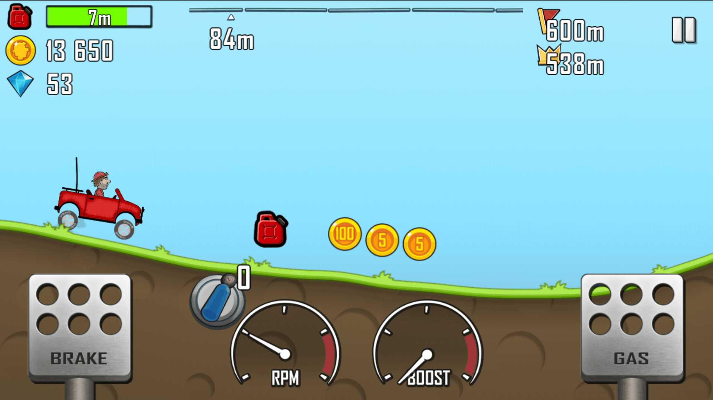
HLL CLIMB RACE

Slide 4
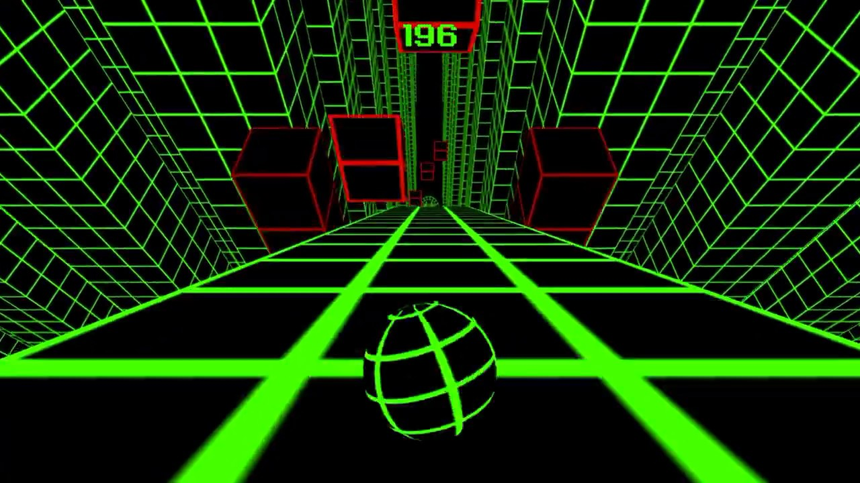

Slide 5
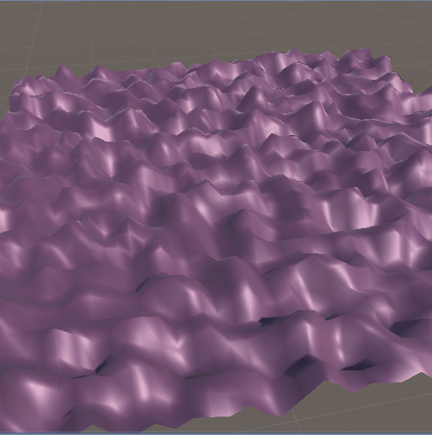
RANDOMNESS

Slide 6
Let’s play

